Slide 1




FlowCloak: Defeating Middlebox-Bypass Attacks in Software-Defined Networking
Middlebox
Kai Bu¹, Yutian Yang¹, Zixuan Guo¹, Yuanyuan Yang², Xing Li¹, Shigeng Zhang³
¹Zhejiang University ²Stony Brook University ³Central South University
Notes:
(Thank you for the introduction) Good afternoon everyone. I’m Yutian Yang, first-year master student from ZJU, I’ m honoered to share with you our recent work on securing middlebox policy enforcement SDN. It’s a joint work with my advisor Kai Bu, Zixuan Guo, Xing Li from ZJU. Professor Yuanyuan Yang form Stony Brook University. Professor Shigeng Zhang from Central South University. In this work, we identify a new kind of attack named Middlebox-Bypass Attacks and present corresponding counter measure.

Slide 2
Middlebox
Notes:
But let’s take our time and start from a hot topic recent years, middlebox first.

Slide 3
Needs
Varieties of functions: Security & Performance
Widely deployed: A third of network devices
Middlebox:
Pain Spot in
modern networks
Troubles
Deployment and configuration:
Complex & Error-prone
Costs: Personnel, Money, Time
Notes:
Whereas, middleboxes gradually become a pain spot in modern networks. This pain comes from both significant needs and endless troubles. Because critical functions beyond switches like security and performance enhancement can be provided by middleboxes, they have been widely deployed in every kind of network. In average, about a third part of a network is comprised of middleboxes. Nevertheless, troubles brought by middleboxes are also far beyond switches as deployment of middleboxes is complex and error-prone. This further costs more personnel, money and time.

Slide 4
Middlebox:
Pain Spot in
modern networks
Notes:
Let me illustrate the complexity in configuring a middlebox policy chain in traditional networks.

Slide 5

Middlebox:
Pain Spot in
modern networks
NAT
Light Firewall
Heavy Firewall
Rules
Rules
Rules
Notes:
In this example, Supposing our administrator would like network flows to pass NAT, Light Firewall and Heavy Firewall in order. He has to write and install rules on all of these switches, which may provide different user interfaces.

Slide 6
Middlebox:
Pain Spot in
modern networks
NAT
Light Firewall
Heavy Firewall
?
Notes:
Once the number of switches increases, this is going to severely confuse our poor administrator.

Slide 7

Middlebox:
Pain Spot
NAT
Light Firewall
Heavy Firewall
SDN
Controller
Notes:
Among many methods providing a more friendly and automatic way to enforce policies, SDN is most widely adopted because it requires no significant change on existing network infrastructure.

Slide 8
Middlebox:
Pain Spot
NAT
Light Firewall
Heavy Firewall
SDN
Rules
Rules
Rules
Controller
Policies
Notes:
The controller of SDN has global view and connection of the whole network. It is able to transform a set of user policies to switch-readable rules and install them. Our administrator can now concentrate only on middlebox-ralated policies through a human-friendly interface. As we can see, SDN has kicked away the pain spot arising from middleboxes.

Slide 9
Middlebox meets
SDN
NAT
Light Firewall
Heavy Firewall
Rules
Rules
Rules
Controller
Policies
Notes:
However, it leaves us a more subtle problem of forwarding ambiguity when middlebox meets SDN.

Slide 10
Middlebox meets
SDN
NAT
Light Firewall (LF)
Heavy Firewall (HF)
H1
S1
S2
S3
L_{E}
Rules
Rules
Rules
H2
Policies:
(1) H1 — NAT — L_{E}
(2) H2 — NAT — LF — HF — L_{E}
Controller
Policies
Alert
Forwarding Ambiguity
Notes:
Consider this simple topology again where our administrator needs to enforce these two policies. He wants all the traffic from H2 to be filtered by LF and if necessary, HF. Meanwhile, packets from H1 simply traverse NAT and go out.

Slide 11
Middlebox meets
SDN
NAT
Light Firewall (LF)
Heavy Firewall (HF)
H1
S1
S2
S3
L_{E}
Rules
Rules
Rules
H2
Policies:
(1) H1 — NAT — L_{E}
(2) H2 — NAT — LF — HF — L_{E}
Controller
Policies
Alert
Forwarding Ambiguity
Notes:
Under this condition, S2 and S3 will have great difficulties judging the source address of a packet.

Slide 12
Middlebox meets
SDN
Ip_src:
H1→?
H2→?
NAT
Light Firewall (LF)
Heavy Firewall (HF)
H1
S1
S2
S3
L_{E}
?
Rules
Rules
?
Rules
H2
Policies:
(1) H1 — NAT — L_{E}
(2) H2 — NAT — LF — HF — L_{E}
Controller
Policies
Alert
Forwarding Ambiguity
Notes:
Because NAT changes IP address of each packet to an unexpected address.

Slide 13
Middlebox meets
SDN
NAT
Light Firewall (LF)
Heavy Firewall (HF)
H1
S1
S2
S3
L_{E}
Rules
Rules
?
Rules
H2
Policies:
(1) H1 — NAT — L_{E}
(2) H2 — NAT — LF — HF — L_{E}
Controller
Policies
Alert
Forwarding Ambiguity
Notes:
Forwarding suspicious packets identified by LF is also problematic for the same reason on S3.

Slide 14
Middlebox meets
SDN
NAT
Light Firewall (LF)
Heavy Firewall (HF)
H1
S1
S2
S3
L_{E}
Stateless
H2
Policies:
(1) H1 — NAT — L_{E}
(2) H2 — NAT — LF — HF — L_{E}
Alert
Notes:
The intrinsic problem lies in the stateless and memoryless nature of IP network layer.

Slide 15
Middlebox meets
SDN
NAT
Light Firewall (LF)
Heavy Firewall (HF)
H1
S1
S2
S3
L_{E}
Stateless→Stateful
H2
Policies:
(1) H1 — NAT — L_{E}
(2) H2 — NAT — LF — HF — L_{E}
Alert
Notes:
So making the network stateful would solve the forwarding ambiguity,

Slide 16
Middlebox meets
SDN
NAT
Light Firewall (LF)
Heavy Firewall (HF)
Switch | Some Crucial Rules
 | Matching | Action
S2 | tag=<src:H2, NAT>, interface=S2:S1 | fwd(LF)
S2 | tag=<src:H1,NAT>, interface=S2:S1 | fwd(S3)
S3 | tag=<src:H2, LF, alert>, interface=S3:S2 | fwd(HF)
S3 | tag=<src:H2, LF, pass> Interface=S3:S2 | fwd(L_{E})
H1
S1
S2
S3
L_{E}
Flowtags [NSDI ’14]
Stateful Tags on packer header
H2
Policies:
(1) H1 — NAT — L_{E}
(2) H2 — NAT — LF — HF — L_{E}
Alert
Notes:
Flowtags in 2014 on NSDI suggests middleboxes add stateful tags on each packet header and controller install corresponding rules on switches. For example, after NAT tags packets, S2 can identify orgin of packets by matching tag field with first two rules. The second policy can be enforced with rules on S3 in a similar way.

Slide 17

Middlebox meets
SDN
Middlebox-Bypass Attacks
Middlebox
NAT
Light Firewall (LF)
Heavy Firewall (HF)
Switch | Some Crucial Rules
 | Matching | Action
S2 | tag=<src:H2, NAT>, interface=S2:S1 | fwd(LF)
S2 | tag=<src:H1,NAT>, interface=S2:S1 | fwd(S3)
S3 | tag=<src:H2, LF, alert>, interface=S3:S2 | fwd(HF)
S3 | tag=<src:H2, LF, pass> Interface=S3:S2 | fwd(L_{E})
H1
S1
S2
S3
L_{E}
H2
Policies:
(1) H1 — NAT — L_{E}
(2) H2 — NAT — LF — HF — L_{E}
Alert
Notes:
However, lack of consideration on security makes a new kind of attack – middlebox-bypass attack possible. In a middlebox-bypass attack, the attacker completely controls some switches, say S2. Then he tries to bypass the security inspection by middleboxes, say LF here by violating the first rule on S2.

Slide 18
Middlebox-Bypass Attacks
NAT
Light Firewall (LF)
Heavy Firewall (HF)
Switch | Some Crucial Rules
 | Matching | Action
S2 | tag=<src:H2, NAT>, interface=S2:S1 | tag(LF, pass) fwd(HF)
S2 | tag=<src:H1,NAT>, interface=S2:S1 | fwd(S3)
S3 | tag=<src:H2, LF, alert>, interface=S3:S2 | fwd(HF)
S3 | tag=<src:H2, LF, pass> Interface=S3:S2 | fwd(L_{E})
H1
S1
S2
S3
L_{E}
Leads to:
Severe security breaches
Performance degradation
H2
Policies:
(1) H1 — NAT — L_{E}
(2) H2 — NAT — LF — HF — L_{E}
Alert
Notes:
Compromised switch S2 first tags the packets as if it had been processed by LF with a non-suspicious result. Then it directly forwards packets to S3.Hence, S3 will deem these packets as benign and forward them out. This kind of attacks lead to severe security breaches as well as performance degradation when the middlebox is a proxy or load balancer.

Slide 19
Middlebox-Bypass Attacks:
More than Hypothesis
NAT
Light Firewall (LF)
Heavy Firewall (HF)
Switch | Some Crucial Rules
 | Matching | Action
S2 | tag=<src:H2, NAT>, interface=S2:S1 | fwd(LF)
S2 | tag=<src:H1,NAT>, interface=S2:S1 | fwd(S3)
S3 | tag=<src:H2, LF, alert>, interface=S3:S2 | fwd(HF)
S3 | tag=<src:H2, LF, pass> Interface=S3:S2 | fwd(L_{E})
H1
S1
S2
S3
L_{E}
Leads to:
Severe security breaches
Performance degradation
H2
Policies:
(1) H1 — NAT — L_{E}
(2) H2 — NAT — LF — HF — L_{E}
Alert
Notes:
Some of you may wonder if it is realistic to compromise a switch in an SDN.

Slide 20
Middlebox-Bypass Attacks:
More than Hypothesis
NAT
Light Firewall (LF)
Heavy Firewall (HF)
H1
S1
S2
S3
L_{E}
Without SSL
H2
Benton et al.
Attacking insecure channel
Notes:
Unfortunately, different attacking methods have already been proposed. Benton et al. find some controller-switch channels are not encrypted by SSL/TLS. The attacker would know how to install arbitrary rules on switches after eavesdropping these channels.

Slide 21
Middlebox-Bypass Attacks:
More than Hypothesis
NAT
Light Firewall (LF)
Heavy Firewall (HF)
H1
S1
S2
S3
L_{E}
Insecure firmware,
e.g. ONIE
Insecure NOSes
H2
Pickett @ DEFCON
Notes:
Pickett @ DEFCON shows us how to leverage insecure firmware and insecure Network Operating Systems on switches to hijack them.

Slide 22
Middlebox-Bypass Attacks:
Existing malicious switch detection methods
Probe-based Methods
Blinded by coward-attack
Waste valuable control channel bandwidth
Statistics-based Methods
False positive (negative)
Waste valuable control channel bandwidth
Notes:
Of course we are not the first one detecting malicious switches in SDN, but are the other ones effective enough for middlebox-bypass attacks? As far as we know, these methods can be divided into Probe-based ones and statistics-based ones. Probe-based methods, however, could be easily blinded by coward-attack, which can distinguish probing packets and production packets and attack only production packets. Statistics-based methods collect statistics of the same flow on each switch en-route. The statistics may fluctuate across switches but when fluctuation exceeds threshold, corresponding switch is deemed malicious. These methods are threshold-based so false positives(negatives) are usually inevitable. Besides, both of the two kinds of methods waste valuable control channel bandwidth to report probe or statistics information to the controller.

Slide 23
Probe-based Methods
Blinded by coward-attack
Waste valuable control channel bandwidth
Middlebox-Bypass Attacks:
Existing Secure Methods
Statistics-based Methods
False positive (negative)
Waste valuable control channel bandwidth
Notes:
In conclusion, they cannot be counted as existing secure methods for middlebox-bypass attacks.

Slide 24
FlowCloak
FlowCloak: Defeating Middlebox-Bypass Attacks in Software-Defined Networking
Middlebox-Bypass Attacks
Notes:
Thus, we present FlowCloak, to address the problem with high accuracy and efficiency.

Slide 25

FlowCloak:
Model
NAT
Light Firewall
Heavy Firewall
？
？
H1
S1
S2
S3
L_{E}
Rules
Rules
Rules
H2
Controller
Notes:
Let me introduce adversary model first. The Controller of an SDN is often deemed secured because it is the root of security and administrators never overlook its importance. All of the middleboxes are benign, too as they often have enough computation resource to protect them from attacks. Moreover, we assume security of the egress switch. There are solutions protecting a single switch, which are too expensive for widely applying. An attacker is able to compromise any other switches in the network. A compromised switch will try every effort to bypass a middlebox.

Slide 26
FlowCloak:
Architecture
ptag verification
NAT_{FlowCloak}
LF_{FlowCloak}
HF_{FlowCloak}
H1
S1
S2
S3
L_{E}
No Cryptography Computation on Switches
Policies:
(1)H1—NAT — L_{E}
(2)H2 — NAT — LF —HF —L_{E}
H2
dtag | ptag
Alert
FlowCloak Tag
Notes:
In FlowCloak, we still adopt a tag to mark a packet’s state and origin, named derterministic tag. However, we add another tag which we call probabilistic tag(ptag). Ptag acts as a proof that the packet is actually processed by the middlebox indicated by the dtag. Each middlebox distributedly verifies ptag set by the former one. As an example here, LF needs to verify ptag of NAT, then followed by HF. The egress switch S3 verifies ptags from NAT, LF or HF for different packets. What’s more, due to limited computational resource on switches, the egress switch is not capable of cryptography computations. So we must consider it as a special condition. This divides our work into two parts: FlowCloak with mb only & another part with egress switch included. Let’s start from an easier condition, mb vs. mb…

Slide 27
FlowCloak:
Architecture
NAT_{FlowCloak}
LF_{FlowCloak}
Notes:
////In this case, a middlebox downstream verification device is another middlebox.

Slide 28
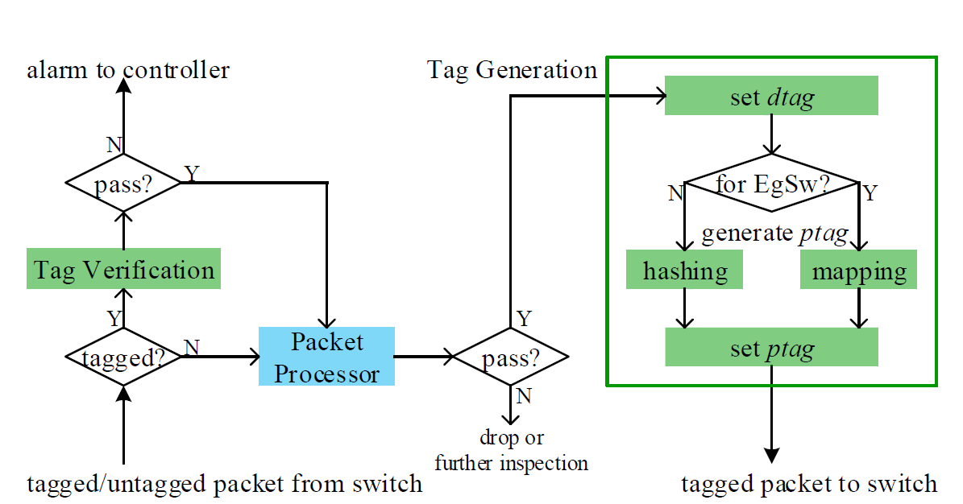
FlowCloak:
Middlebox vs. Middlebox
NAT_{FlowCloak}
LF_{FlowCloak}
Packet Processing Logic on FC Middleboxes
Notes:
FlowCloak adds tag verification and tag generation modules to middleboxes.

Slide 29
FlowCloak:
Middlebox vs. Middlebox
NAT_{FlowCloak}
LF_{FlowCloak}
TAGVERIFICATION(P) if isexist(P. dtag, dtagmap) then ptag’ = Hash(Sample(P. Header)) if(ptag’ == P.Header.ptag) return TRUE return FALSE TAGVERIFICATION ends
Packet Processing Logic on FC Middleboxes
Notes:
Tag Verification module verifies both a packet‘s dtag and ptag.

Slide 30
FlowCloak:
Middlebox vs. Middlebox
TAGGENERATION(P) if next_dev(P) == DEV.MIDDLEBOX then dtag = flowtags(P, self.ID, Controller) writedtag(P, dtag) ptag = Hash(Sample(P. Header)) writeptag(P, ptag) else ptag = Map(Sample(P. Header)) TAGGENERATION ends
Packet Processing Logic on FC Middleboxes
Notes:
Tag generation tags the packet with new ptag, which is generated by hashing over certain sample fields. Whereas, if next device is an egress switch, we adopt a faster hashing function to generate multiple tags, called mapping function here. To figure out how it works, we shall study how an egress switch verifies ptags.

Slide 31
FlowCloak:
Middlebox vs. Switch
No cryptography computation: Simulating the hashing function using only match-forward rules
Egress Switch Rules
Matching | Action
P.SampleDomain=0 && P.Header.ptag=1 | forward
P.SampleDomain=1 && P.Header.ptag=0 | forward
Hash(b)=~b:
Hash(0)=1
Hash(1)=0
Notes:
As no cryptography computation is allowed on an egress switch, it needs to simulate the hashing function with only match-forward rules. Here we give a simple example on how to simulate this hashing function below. //The input of the hashing function is the sample domain and ptag field is its ouput.

Slide 32
FlowCloak:
Middlebox vs. Switch
No cryptography computation: Simulating the hashing function using only match-forward rules
Satisfying Security means Sufficient Rules
Egress Switch Rules
Matching | Action
P.SampleDomain=0 && P.Header.ptag=1 | forward
P.SampleDomain=1 && P.Header.ptag=0 | forward
Hash(b)=~b:
Hash(0)=1
Hash(1)=0
Notes:
Obviously, security of this hashing function is far from enough. We need one with a longer input and output, which needs more rules to simulate.

Slide 33
FlowCloak:
Middlebox vs. Switch
Length(P.SampleDomain)=1
2 rules;
…
Length(P.SampleDomain)=n
2^{n} rules;
Too many rules for limited TCAM capacity
Egress Switch Rules
Matching | Action
P.SampleDomain=0 && P.Header.ptag=1 | forward
P.SampleDomain=1 && P.Header.ptag=0 | forward
Hash(b)=~b:
Hash(0)=1
Hash(1)=0
Notes:
But the number of rules increase exponentially as bit length of input grows, which means the limited TCAM memory on egress switch can be easily run out. Nevertheless, we find that taking full use of multiple flow tables can significantly decrease the number of rules.

Slide 34
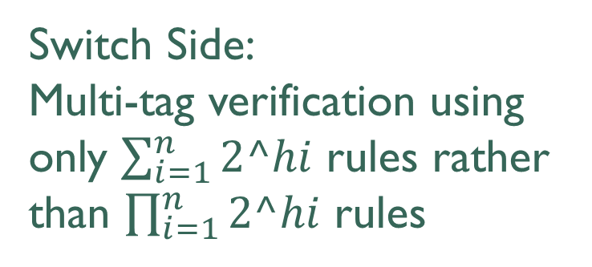
FlowCloak:
Middlebox vs. Switch
h1 bits | h2 bits | h3 bits
Multi-tag technology
Middlebox Side:
Multi-tag generation based on parallel generation and hashing table.
g1 | g2 | g3
Switch Side:
Multi-tag verification using only $\sum_{i=1}^{n}{2^hi}$ rules rather than $\prod_{i=1}^{n}{2^hi}$ rules
Flow Table 1
Flow Table 2
Flow Table 3
Notes:
To put it in detail, on middlebox side, we divide the sample field into different parts first and then hash them respectively. We combine the hashing results together to form the ptag. On the switch side, we leverage pipelined multiple flow tables to verify each part of the ptag. Assume length of each part of sample field is h_i. The number of needed rules dramatically decreases from the product of 2 to h_i to the sum of them.

Slide 35
FlowCloak:
Middlebox vs. Switch
h1 bits | h2 bits | h3 bits
Caveat:
Each tag becomes shorter
→Attacking each part becomes easier?
g1 | g2 | g3
Flow Table 1
Flow Table 2
Flow Table 3
Notes:
But length of each part of tag is definitely shorter than the original ptag. It’s a caveat whether an attack on partial ptag becomes easier.

Slide 36
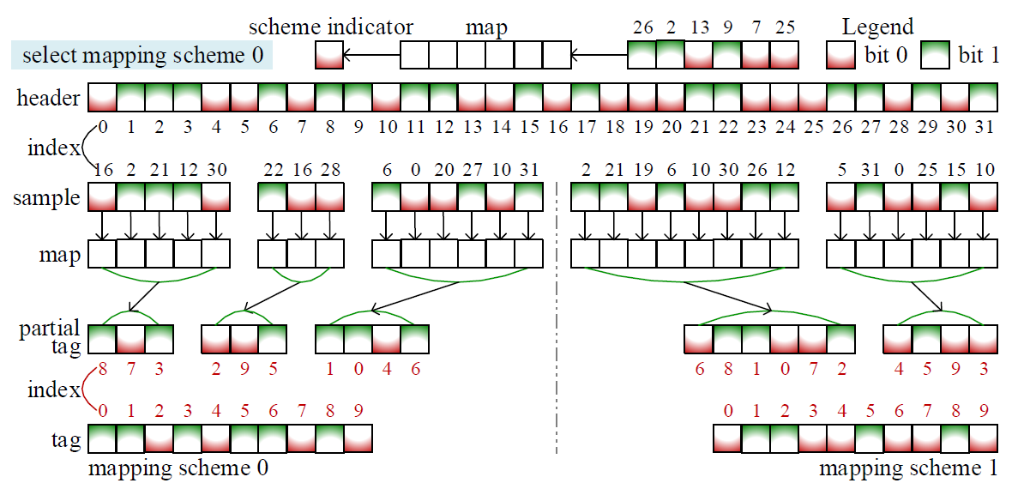
FlowCloak:
Middlebox vs. Switch
Shuffle 1
Shuffle 2
More sophisticated mapping:
multiple mapping schemes + nonconsecutive sample bits + double shuffle
Notes:
Keeping this in mind, we suggest applying a set of different mapping scheme for different packets. What’s more, we sample nonconsecutive bitss in packet headers and shuffle these bits before and after mapping. With this more sophisticated mapping method, we are sure that FlowCloak is highly secured because attackers know nothing about which field to sample, how to shuffle or which mapping scheme is chosen. Furthermore, we suggest periodically changing to different mapping schemes.

Slide 37
FlowCloak:
Evaluation -- Environment
Middlebox: Snort, 387/29300 lines of C code modified
SDN: OpenDayLight Carbon as Controller
OVS v2.5.3 as switches
Mininet for network simulation
Hardware: Each Snort instance is assigned with
8GB memory and 2 2.3GHz(E5-2670 v3) CPUs
Notes:
So far, I have displayed our method in detail but how it actually performs depends on our final evaluation. Evaluation environment is listed as below: we choose snort, most widely used IDS/IPS as middlebox while modify only 300+ lines of C code. We choose OpenDayLight Carbon as Controller, OVS as switches and Mininet to simulate the network.

Slide 38
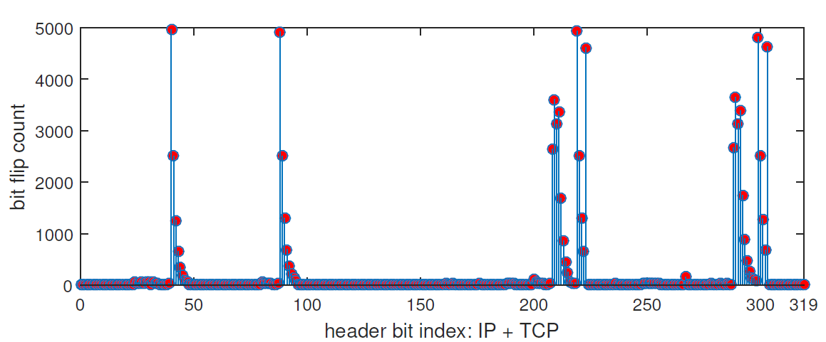
FlowCloak:
Evaluation -- Feasibility
packet header dynamics in 5000 sniffed co-flow packets
Is there sufficient diversity in packet headers?
Notes:
First, we would like to prove that our method is feasible from the point of packet header diversity. If packet headers were static most of the time, diversity of ptag would also be insufficient under an enumeration attack.

Slide 39
FlowCloak:
Evaluation -- Feasibility
packet header dynamics in 5000 sniffed co-flow packets
Fortunately, we get enough dynamics in packet headers.
Notes:
We measure header diversity over 5000 sniffed co-flow packets. Fortunately, we find that 18bits change over 50% of packet-wise comparisons.24 bits change more than 1000 times. The diversity is quite sufficient as we choose a 10-bit space in a packet header as ptag.

Slide 40
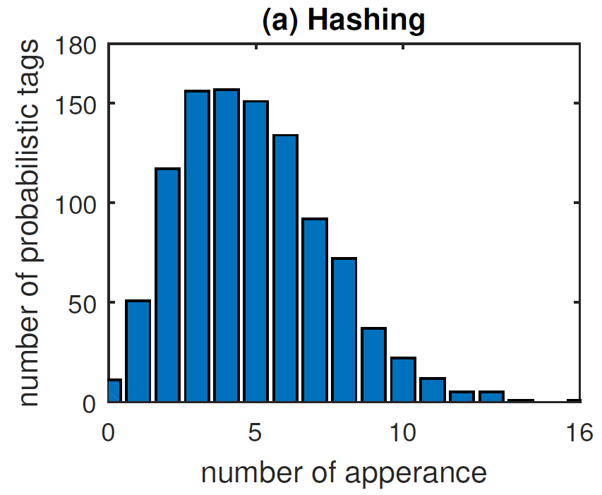
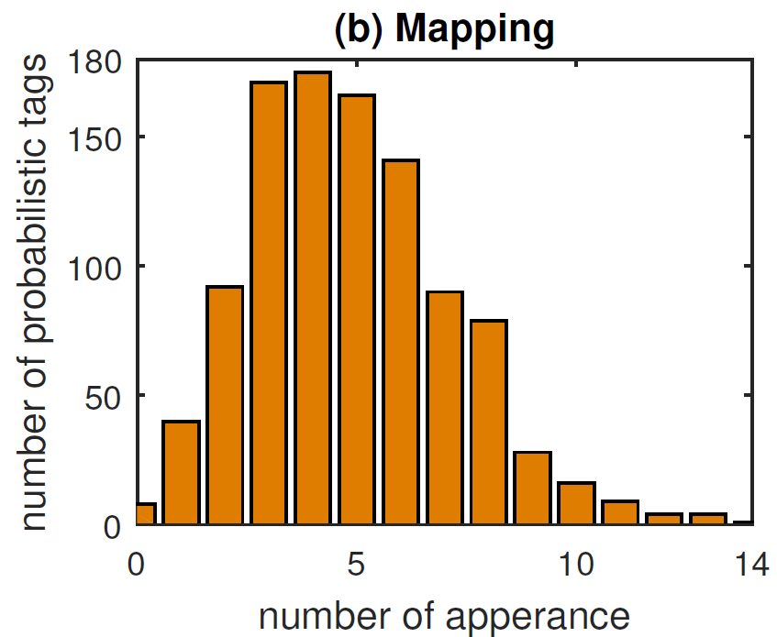
FlowCloak:
Evaluation -- Robustness
ptag distribution under hashing and mapping
Can attackers find any pattern in ptag?
Notes:
Next, we measure the distribution of ptags. Ideal ptags must distribute independently and evenly, or a ptag may be easier to guess compared with random guessing.

Slide 41
FlowCloak:
Evaluation -- Robustness
ptag distribution under hashing and mapping Both approximate binomial distribution
Notes:
We use FNV-1a as hashing & partial-mapping function, finding both of the output distribution can approximate binomial distribution. This indicates our method is robust enough against ptag guessing.

Slide 42
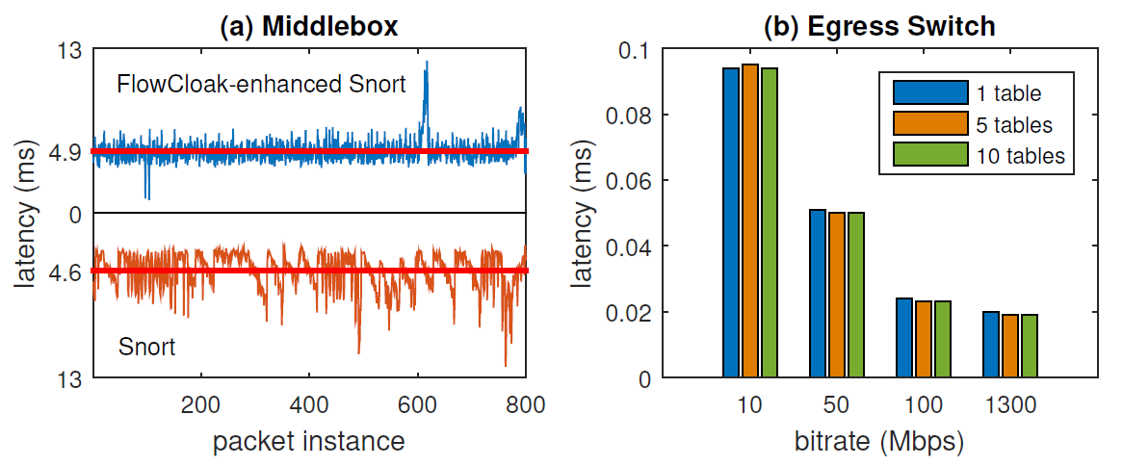
FlowCloak:
Evaluation -- Efficiency
overhead of FlowCloak
Is performance degradation acceptable?
Notes:
Robust security with significant performance degradation is meaningless. So we measure and compare the latency between FlowCloak uninstalled & installed environment, on both middleboxes and egress switch.

Slide 43
FlowCloak:
Evaluation -- Efficiency
overhead of FlowCloak
Latency induced by FlowCloak on Middlebox: 0.3 ms
Latency induced by multiple flow tables: no obvious delay
Notes:
Only 0.3 ms more latency is observed on middlebox after applying FlowCloak. To our surprise, we can see no obvious latency induced by FlowCloak on egress switch because of its high speed in processing pipelined flow tables.

Slide 44
FlowCloak:
FlowCloak: Defeating Middlebox-Bypass Attacks in Software-Defined Networking
Notes:
We can finally conclude that FlowCloak, a novel method, can definitely beat middlebox-bypass attacks with efficiency and robustness.

Slide 45
Middlebox meets SDN
FlowCloak: Defeating Middlebox-Bypass Attacks in Software-Defined Networking
Middlebox-bypass attacks
FlowCloak & Multi-tag technology
Efficient, Accurate & Robust
Notes:
Without radical infrastructure changes, SDN greatly simplifies middlebox policy enforcement. But lack of security in existing tagging methods makes it possible for middlebox-bypass attacks. By adding probabilistic tags to packet headers and applying multi-tag technology on egress switch, we address the problem in an efficient, accurate and robust manner. Our evaluation indicates that FlowCloak is suitable for deployment in SDN nowadays. Thank you for your time and interest.

Slide 46
?
Notes:
Now I’m happy to take any questions, thank you.

Slide 47

Thank You
ytyang@zju.edu.cn
Notes:
Thank you again and wish you have a nice trip in Honolulu.

